Slide 1
Coursera IBM Data Science Certification –
Capstone Project
Piyush Jagtap

Slide 2
Contents
◆ Introduction Section:
Discussion of the "background situation" leading to the problem at hand:
Problem to be resolved
Audience for this project.
◆ Data Section:
Data of Current Situation (current residence place)
Data required to resolve the problem
Data sources and data manipulation
◆ Methodology Section:
Process steps and strategy to resolve the problem
Data Science Methods, machine learning, mapping tools and exploratory data analysis.
◆ Results Section
Discussion of the results and how they help to take a decision.
◆ Discussion Section
Elaboration and discussion on any observations and/or recommendations for improvement.
◆ Conclusion Section
Decision taken and Report Conclusion.

Slide 3
1. Introduction Section :
◆ 1.1 Scenario and Background
◆ I am a data scientist residing in Dwarka, New Delhi, India. I currently live within walking distance to many amenities and venues in the area, such as various international cuisine restaurants, cafes, gyms, food shops and entertainment.
◆ I have been offered a great opportunity to work in Manhattan, NY. Although, I am very excited about it, I am a bit stress toward the process to secure a comparable place to live in Manhattan. Therefore, I decided to apply the learned skills during the Coursera course to explore ways to make sure my decision is factual and rewarding. Of course, there are alternatives to achieve the answer using available Google and Social media tools, but it rewarding doing it myself with learned tools.
◆ 1.2 Problem to be resolved:
◆ The challenge to resolve is being able to find an apartment unit in Manhattan NY that offers similar characteristics and benefits to my current situation. Therefore, in order to set a basis for comparison, I want to place subject to the following conditions:
◆ Top amenities in the selected neighborhood shall be similar to current residence (See item 2.1)
◆ Desirable to have venues such as Gyms, Restaurants, wine stores, and food shops
◆ As a reference, I have included a map of venues near current residence in Dwarka New Delhi.
◆ 1.3 Interested Audience
◆ I believe this is a relevant project for a person or entity considering moving to a major city in Europe, US or Asia, since the approach and methodologies used here are applicable in all cases.
◆ The use of FourSquare data and mapping techniques combined with data analysis will help resolve the key questions arisen.
◆ Lastly, this project is a good practical case toward the development of Data Science skills.

Slide 4
2. Data Section:
◆ Description of the data and its sources that will be used to solve the problem
◆ 2.1 Data of Current Situation
◆ I Currently reside in the neighborhood of Dwarka in New Delhi, India. I use Foursquare to identify the venues around the area of residence which are then shown in the New Delhi map shown in methodology and execution in section 3.0 . It serves as a reference for comparison with the desired future location in Manhattan NY
◆ 2.2 Data Required to resolve the problem
◆ In order to make a good choice of a similar apartment in Manhattan NY, the following data is required:
◆ List/Information on neighborhoods form Manhattan with their Geodata(latitude and longitude).
◆ Venues and amenities in the Manhattan neighborhoods (e.g. top 10)

Slide 5
2. Data Section:
◆ 2.3 sources and manipulation
◆ The list of Manhattan neighborhoods is worked out during LAB exercise during the course. A csv file was created which will be read in order to create a data frame and its mapping.
◆ 2.4 How the data will be used to solve the problem
◆ The data will be used as follows:
◆ Foursquare and geopy data to map top 10 venues for all Manhattan neighborhoods and clustered in groups ( as per Course LAB)
◆ 2.5 Mapping of Data
◆ The following maps were created to facilitate the analysis and the choice of the palace to live.
◆ Manhattan map of Neighborhoods
◆ Manhattan map of clustered venues and neighborhoods

Slide 6
3. Methodology section:
◆ This section represents the main component of the report where the data is gathered, prepared for analysis. The tools described are used here and the Notebook cells indicates the execution of steps.
◆ The analysis and the strategy:
◆ The strategy is based on mapping the above described data in section 2.0, in order to facilitate the choice of a candidate places for accommodation. The choice is made based on the demands imposed : similar venues to Dwarka, New Delhi, India. This visual approach and maps with popups labels allow quick identification of location, thus making the selection very easy.
◆ The processing of these DATA and its mapping will allow to answer the key questions to make a decision:
◆ What are the venues of the best place to live?
◆ How venues distribute among Manhattan neighborhoods ?

Slide 7

4. Results

Slide 8
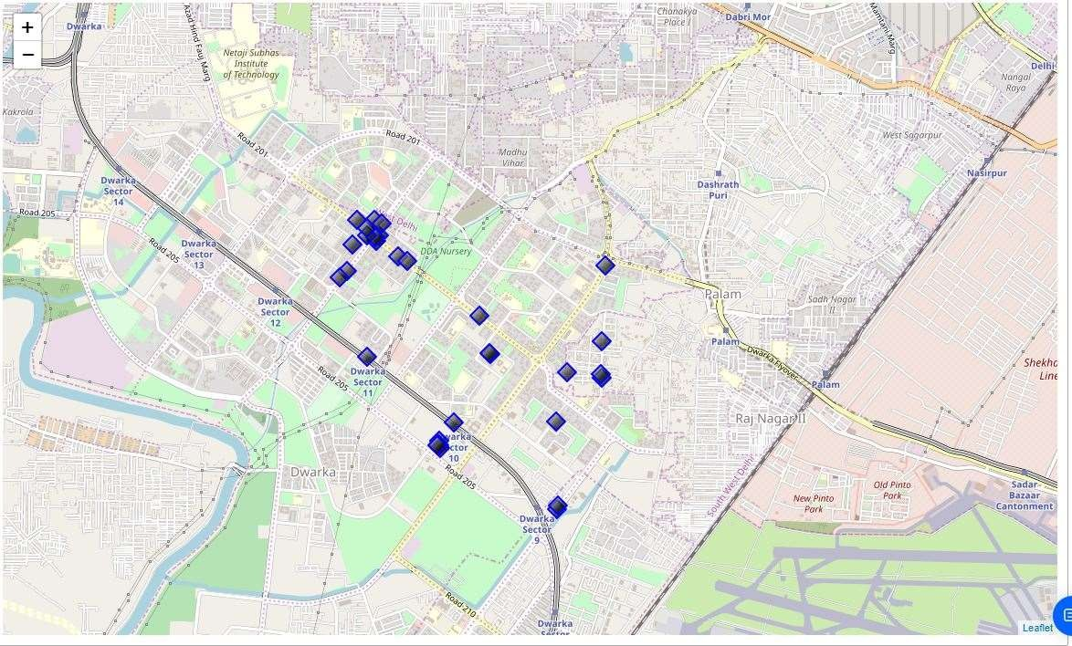
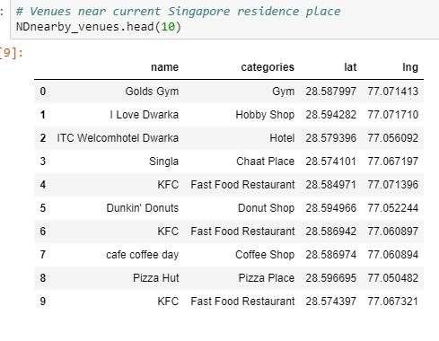
Current Residence in Singapur

Slide 9
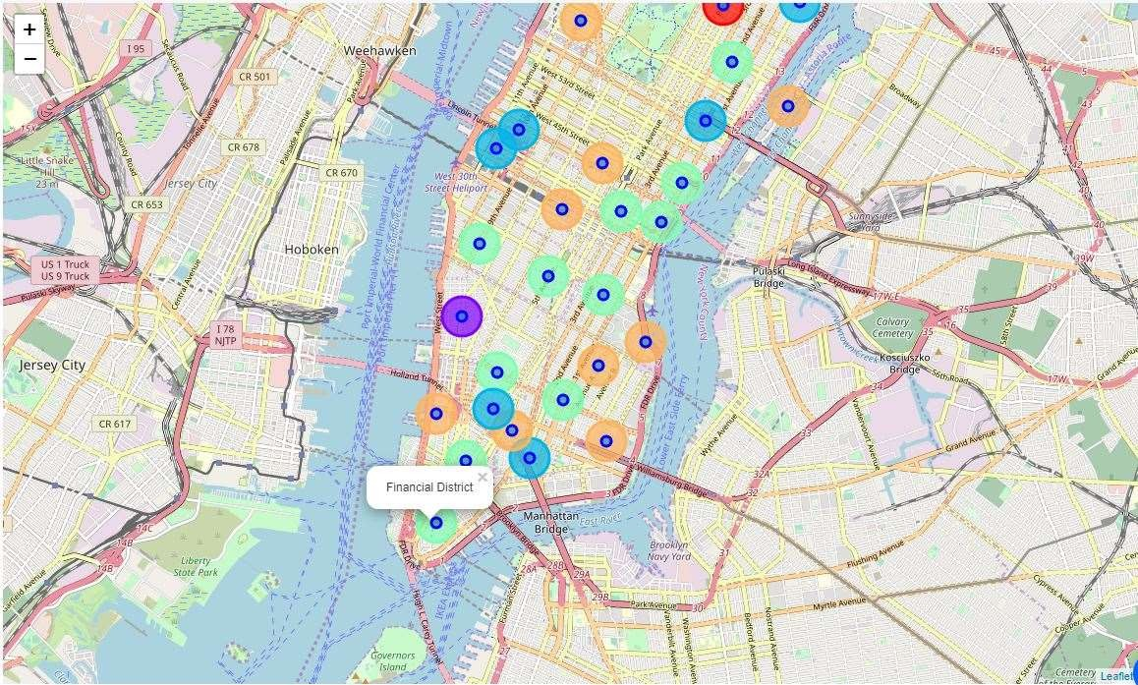
Clusters of Neighbourhoods in Manhattan

Slide 10
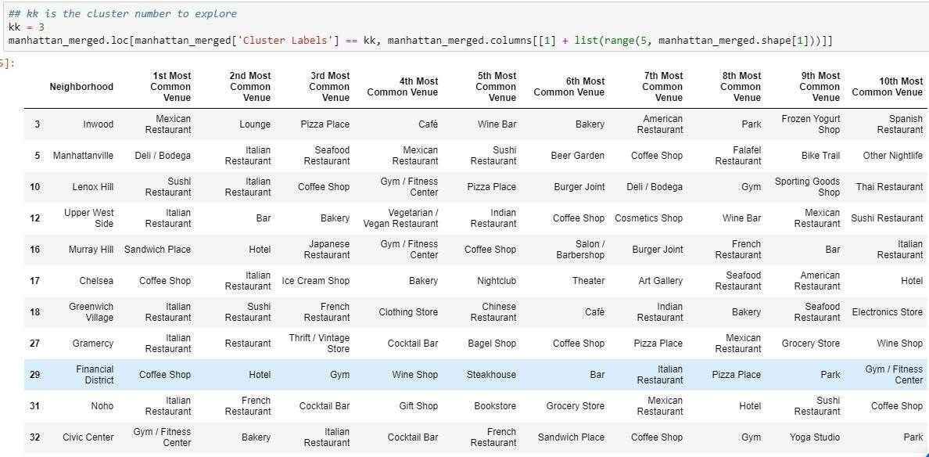
On Careful Examination, Financial District in Cluster
3 resembles in amenities to our Current Residence

Slide 11
Venue Selection
◆ Using the "one map" above, I was able to explore all possibilities since the popups provide the information needed for a good decision.
◆ Financial District having Gyms, Hotels and Restaurants similar to New Delhi residence is my preferable choice for a future residence.
◆ Based on current New Delhi venue, I feel that Cluster 3 type of venues is a closer resemblance to my current place. That means that Financial District is a better choice since it has Gyms, Hotels and Restaurant and is worth the conveniences it provides.

Slide 12
5.0 DISCUSSION
◆ In general, I am positively impressed with the overall organization, content and lab works presented during the Coursera IBM Certification Course
◆ I feel this Capstone project presented me a great opportunity to practice and apply the Data Science tools and methodologies learned.
◆ I have created a good project that I can present as an example to show my potential.
◆ I feel I have acquired a good starting point to become a professional Data Scientist and I will continue exploring to creating examples of practical cases

Slide 13
6.0 CONCLUSION
◆ I feel rewarded with the efforts, time and money spent. I believe this course with all the topics covered is well worthy of appreciation.
◆ This project has shown me a practical application to resolve a real situation that has impacting personal and financial impact using Data Science tools.
◆ The mapping with Folium is a very powerful technique to consolidate information and make the analysis and decision thoroughly and with confidence. I would recommend for use in similar situations.
◆ One must keep abreast of new tools for Data Science that continue to appear for application in several business fields.

